Slide 1
JOURNAL CLUB Daridorexant
BY
DR.AARTHIPRIYANKA
POST GRADUATE
DEPARTMENT OF PHARMACOLOGY

Slide 2
Daridorexant - INDICATION
Daridorexant hydrochloride
Approved by FDA on 7 January 2022
Indicated for insomnia characterized by difficulties with sleep onset and/or sleep maintenance.

Slide 3
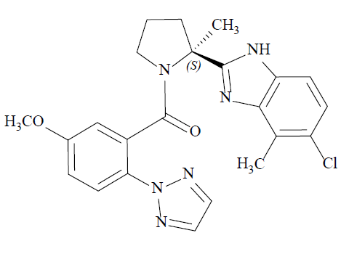
CHEMICAL DESCRIPTION
molecular formula - C23H23N6O2Cl * HCl
molecular weight - 487.38 g/mol.
Structural formula –
(S)-(2-(5-chloro-4-methyl-1H-benzo[d]imidazol-2-yl)-2-methylpyrrolidin-1-yl)(5­ methoxy-2-(2H-1,2,3-triazol-2-yl)phenyl)methanone hydrochloride

Slide 4
PHARMACOKINETICS
Administration : Oral,Tablets: 25 mg, 50 mg.
Absorption: Tmax - 1–2 hours ,
bioavailability of 62%
Distribution :volume of distribution- 31 L
99.7% bound to plasma proteins
Elimination : half-life-8 hours
Metabolism : CYP3A4 (89%)
Excretion : faeces 57%, urine 28% as metabolites

Slide 5
Mechanism of Action
antagonism of orexin receptors
The orexin neuropeptide signaling system plays a role in wakefulness.
Blocking the binding of wake-promoting neuropeptides orexin A and orexin B to receptors OX1R and OX2R is thought to suppress wake drive.

Slide 6
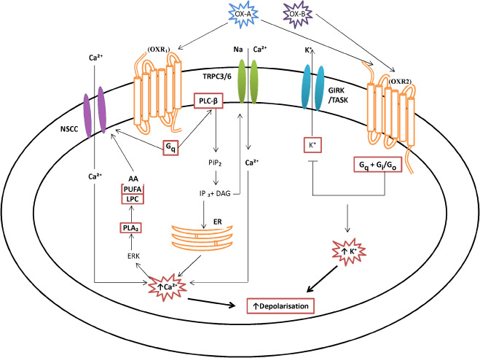
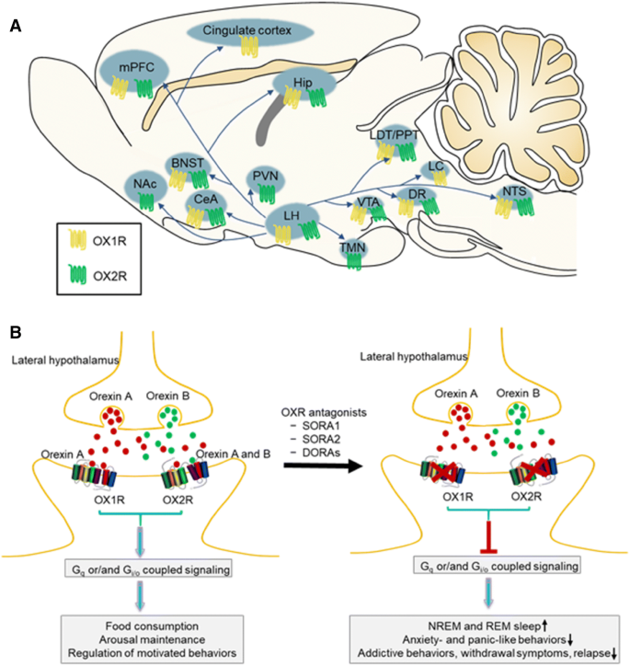

Slide 7
Pharmacodynamics
Daridorexant binds to and inhibits the orexin receptors OX1R and OX2R (Ki = 0.47 and 0.93 nM, respectively).
Cardiac Electrophysiology:
At a dose 4 times the maximum recommended dose,Daridorexant does not prolong the QTc interval to any clinically relevant extent

Slide 8
CLINICAL STUDIES
The efficacy of Daridorexant was evaluated in two multicenter, randomized, double-blind, placebo controlled, parallel-group studies
DSM-5 insomnia persons of total 1854
Study 1 (NCT03545191) Study 2 (NCT03575104)
Total:930 persons total:924
Randomized to Randomized to
Daridorexant 50mg – 310 persons Daridorexant 25mg – 309 persons
Daridorexant 25mg – 310 persons Daridorexant 10mg – 307 persons
Placebo - 310 persons Placebo – 308 persons
Once daily for 3 months
↓ 7 day placebo run out period
Study 3, NCT03679884
Double blind,placebo controlled extension study for 9 months
Total:600, 373 treated for 12 months,227 treated for atleast 6 months

Slide 9
Primary efficacy endpoints:
Latency to Persistent Sleep (LPS)
Wake After Sleep Onset (WASO),
measured objectively by polysomnography in a sleep laboratory.
LPS is a measure of sleep induction
WASO is a measure of sleep maintenance.
Secondary endpoint:
statistical testing hierarchy with Type 1 error control
patient-reported Total Sleep Time (sTST)
evaluated every morning at home using a validated Sleep Diary Questionnaire (SDQ).

Slide 10
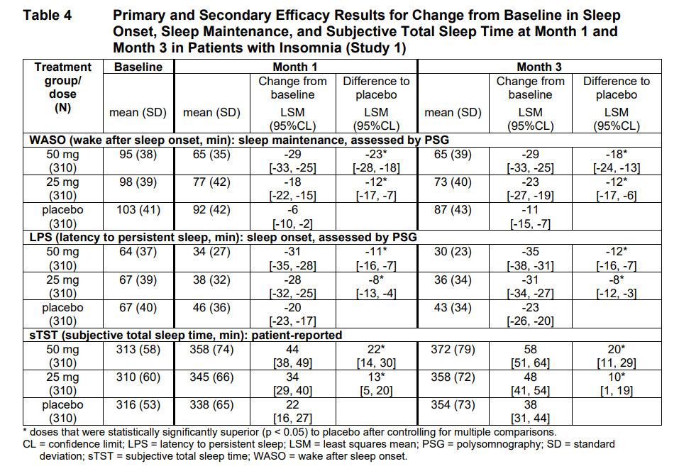

Slide 11
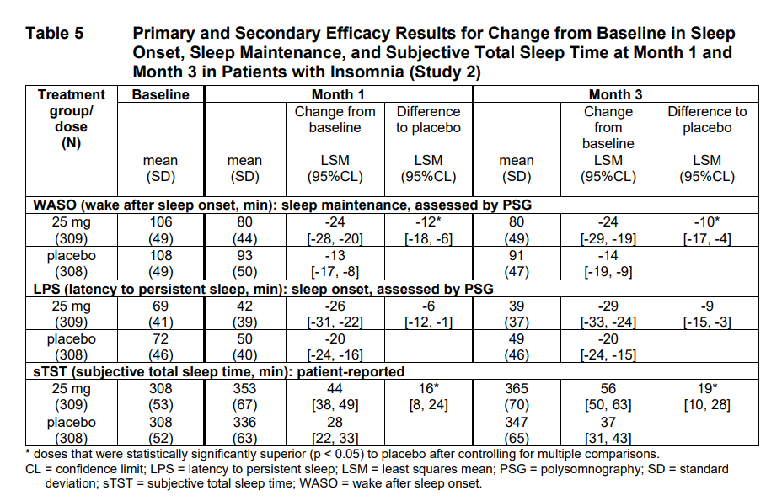

Slide 12
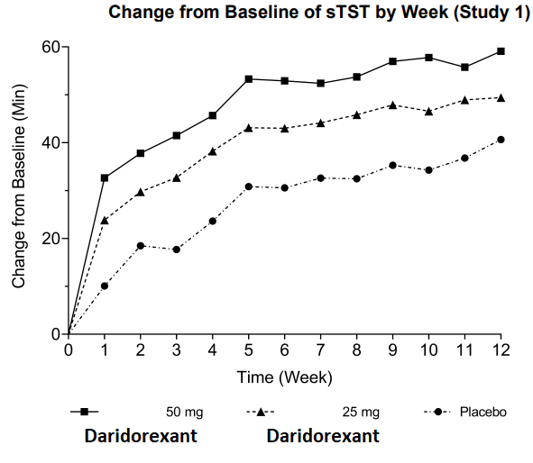

Slide 13
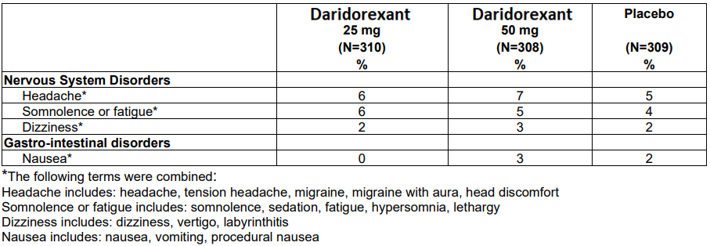
ADVERSE EFFECTS

Slide 14
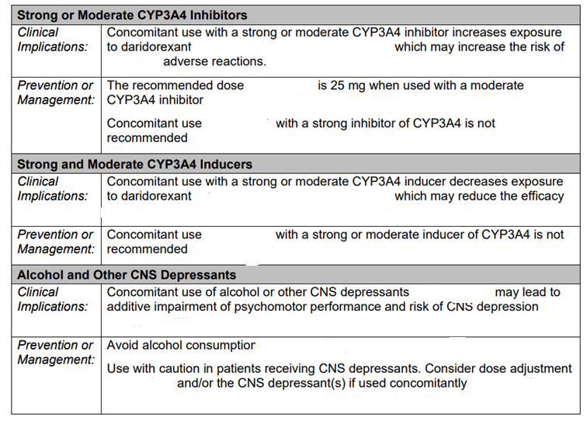
DRUG INTERACTIONS

Slide 15
CONTRAINDICATION
Narcolepsy

Slide 16
Abuse
In placebo-controlled Phase 3 clinical studies in which 1232 subjects with insomnia were treated with Daridorexant for up to 12 months, there were no reports indicative of abuse liability.
Because individuals with a history of abuse of or addiction to alcohol or other drugs may be at increased risk for abuse of or addiction to Daridorexant, follow such patients carefully.

Slide 17
Dependence
In animal studies and clinical trials evaluating physical dependence, chronic administration of daridorexant did not produce withdrawal signs or symptoms upon drug discontinuation. This suggests that daridorexant does not produce physical dependence

Slide 18
USE IN SPECIFIC POPULATIONS
Pregnancy -no available human data
Lactation – no human data available
Pediatric Use- The safety and effectiveness have not been established in pediatric patients.
Geriatric Use- No dose adjustment is required in patients over the age of 65 years.
Carcinogenesis- no human data available
Mutagenesis- no human data available
Impairment in fertility- no impairment of fertility in animal studies

Slide 19
Hepatic Impairment
has not been studied in patients with severe hepatic impairment (Child-Pugh score ≥ 10).
Reduce the dose in patients with moderate hepatic impairment (Child-Pugh score 7–9
Moderate hepatic impairment may increase daridorexant systemic exposure to a clinically relevant extent which may increase the frequency or severity of adverse reactions.

Slide 20
PHARMACOECONOMICS
Available from may 2022
Estimated price ranging from $5 to $650 (single dose to multiple doses)

Slide 21
Thank you

